Slide 1
Introduction to Web Application

Slide 2
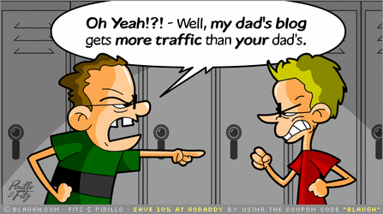
Enter 21st Century!

Slide 3
INTERNET & THE WEB
The Internet is a global system of interconnected computer networks that use the standard Internet Protocol Suite (TCP/IP) to serve billions of users worldwide.
The Internet is a global data communications system. It is a hardware and software infrastructure that provides connectivity between computers.

Slide 4
WHAT’S THE WORLD WIDE WEB?
The Web is a system of interlinked hypertext documents accessed via the Internet
3 first bricks:
Uniform Resource Locator (URL) i.e.,
unique identifiers for resources on the Web
HyperText Markup Language (HTML)
i.e., the publishing language
Hypertext Transfer Protocol (HTTP)
i.e., the exchange protocol

Slide 5
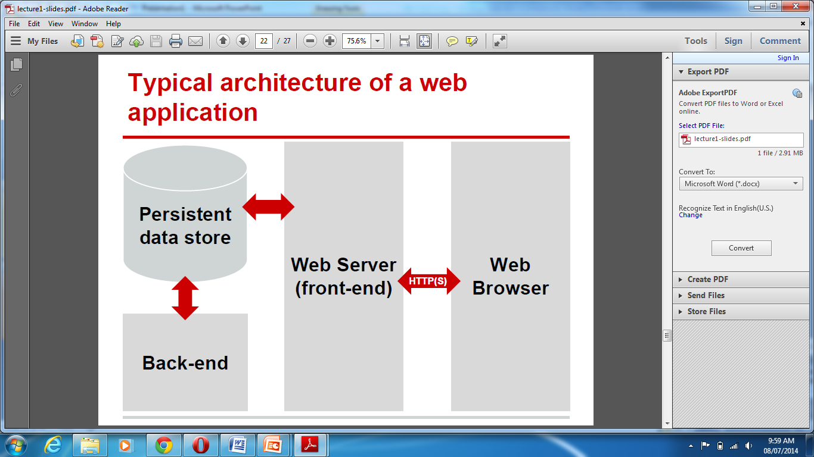
Typical architecture of a web application

Slide 6
Web browser
Mainly user interface,
Short term state (in general),
May implement some logic, especially for fast response time (but untrusted),
Communicate with the web server using HTTP(S),
Executing HTML, CSS and JavaScript code.

Slide 7
Web browser
Main task :
Generate and submit web requests to web servers
Accept responses from web servers and produce visual presentations out of it
Render the results

Slide 8
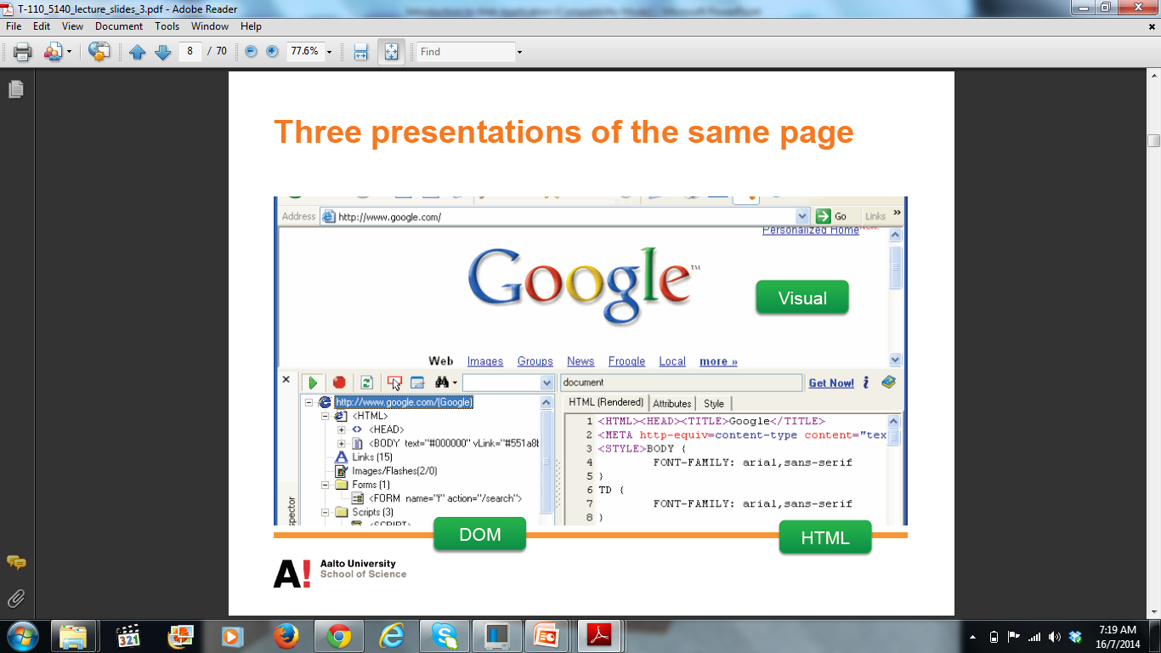

Slide 9
Web server (front-end)
Answers to HTTP(S) requests from the web clients,
Reads and writes data in a persistent data store,
Performs most of the business logic,
Consists in a general of a server/container(Apache, Tomcat) and a framework (PHP, Java Servlets, etc.) running business logic.

Slide 10
Data store
The state of the web application,
Historically a (My)SQL database, some more recent evolutions,
The synchronisation point.

Slide 11
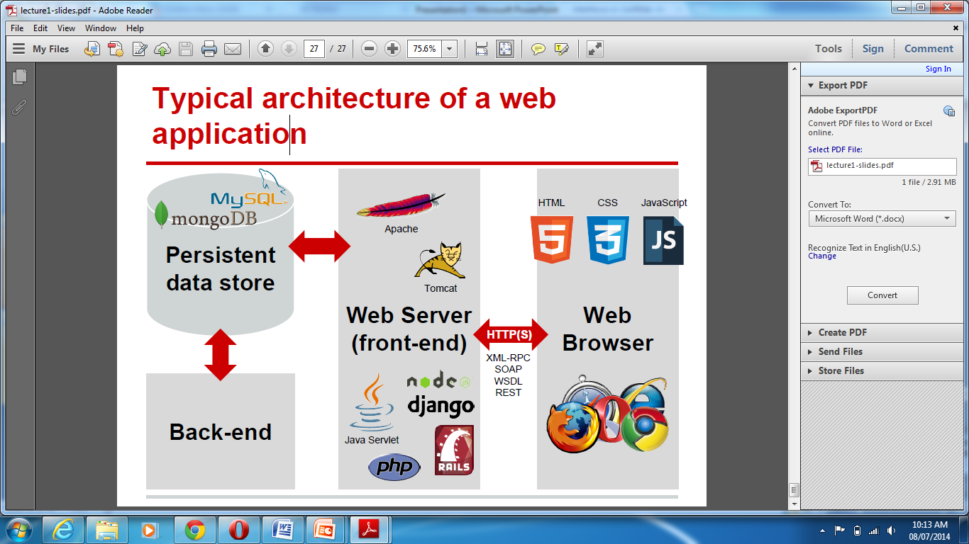

Slide 12
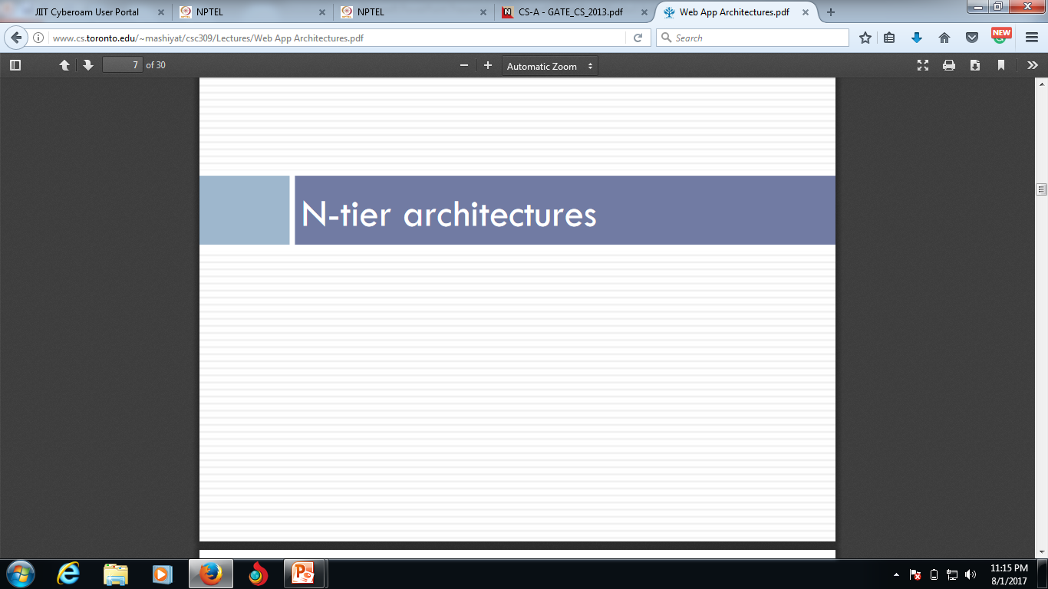

Slide 13
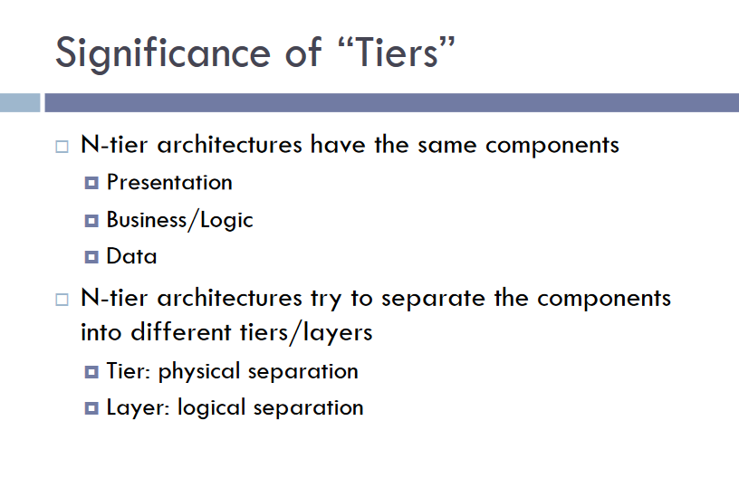

Slide 14
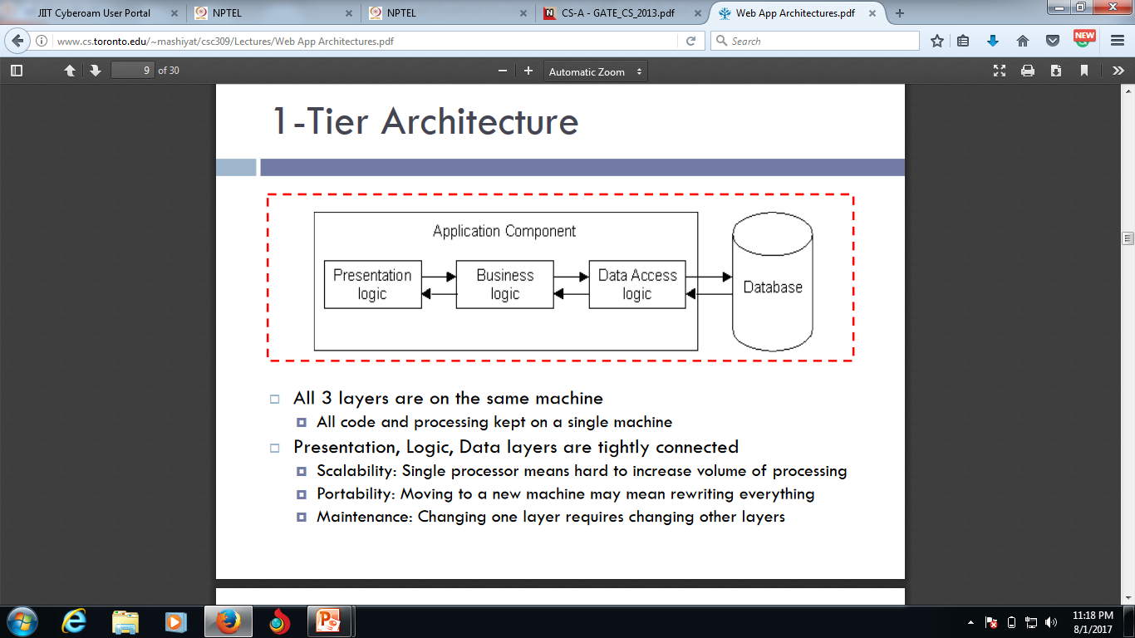

Slide 15
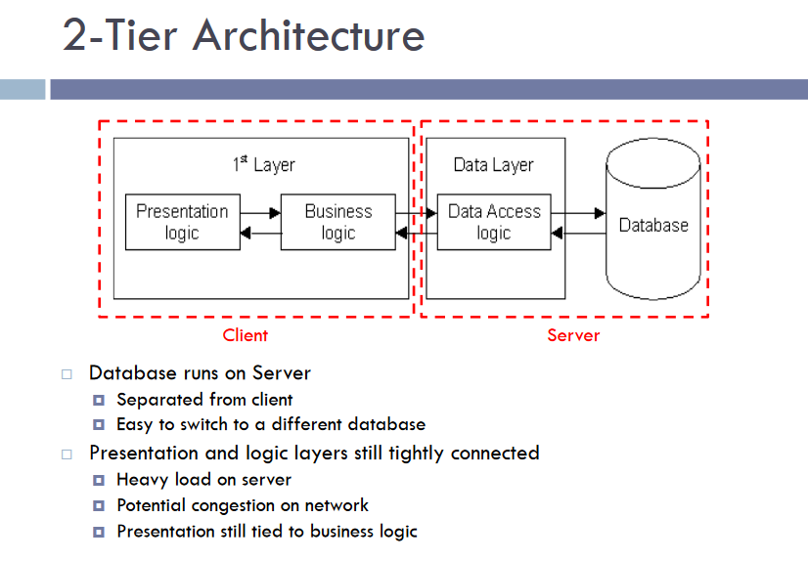

Slide 16
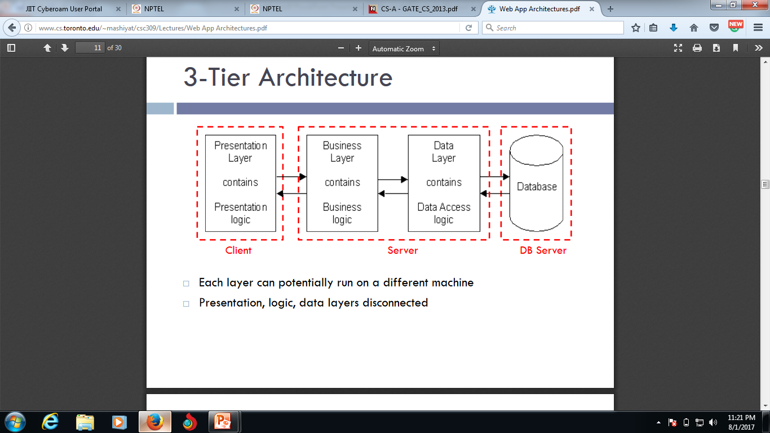

Slide 17
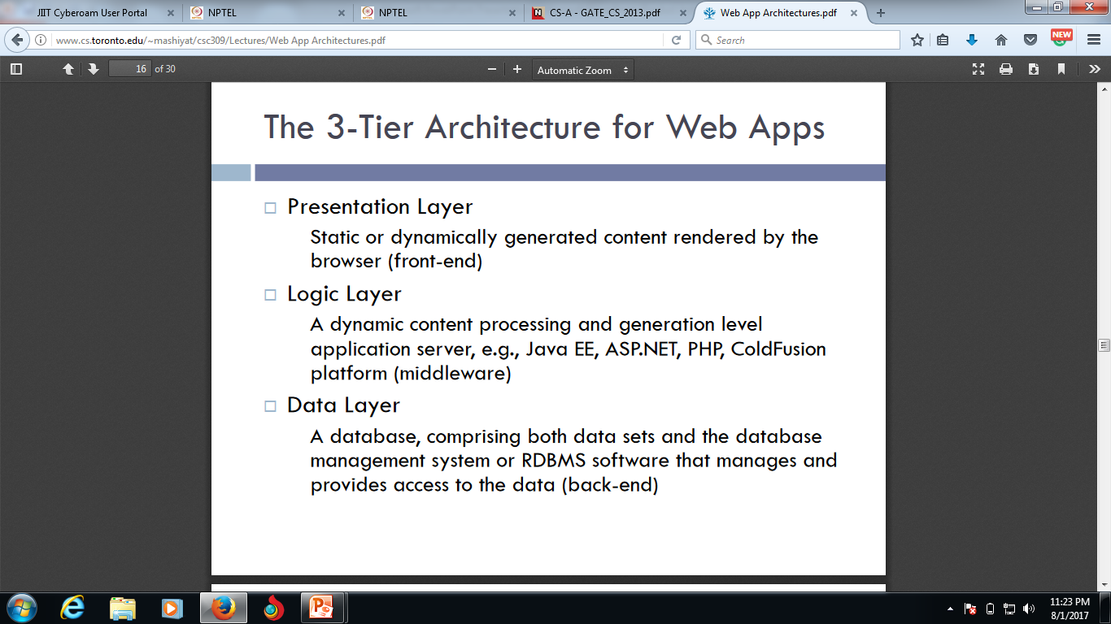

Slide 18
